Slide 1
ItR Final
Demetrius Rauck

Slide 2
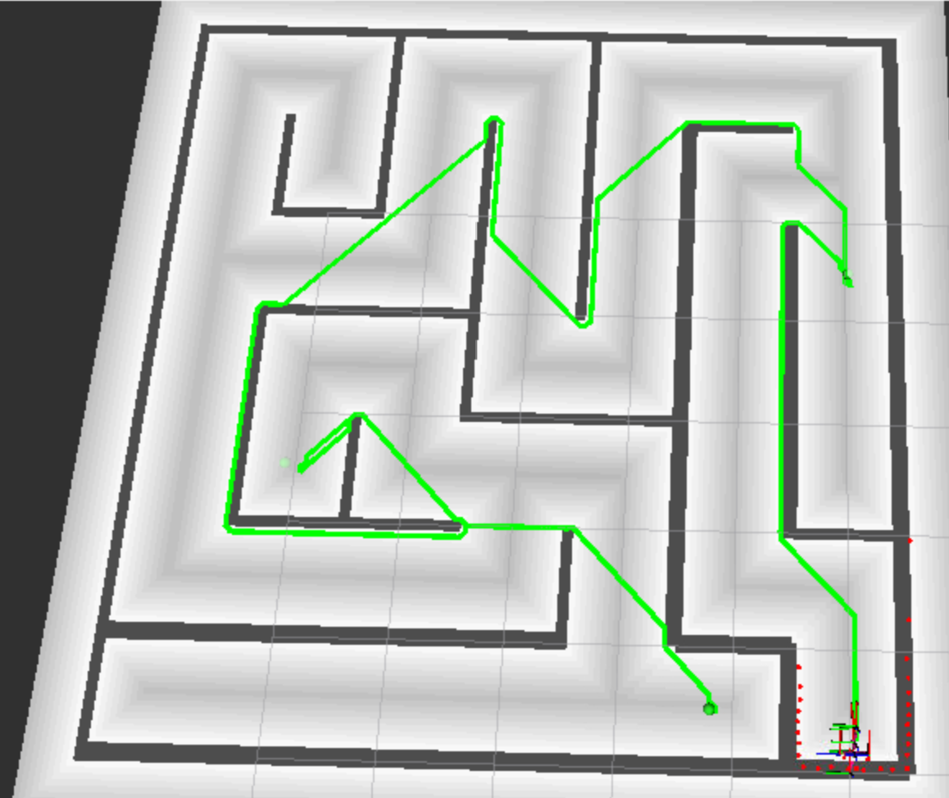
Planning Algorithm:
A* Pathfinding
Creates graph based off of map with a the same grid resolution
Key Modifications
Chain
Distance Map Heuristic

Slide 3
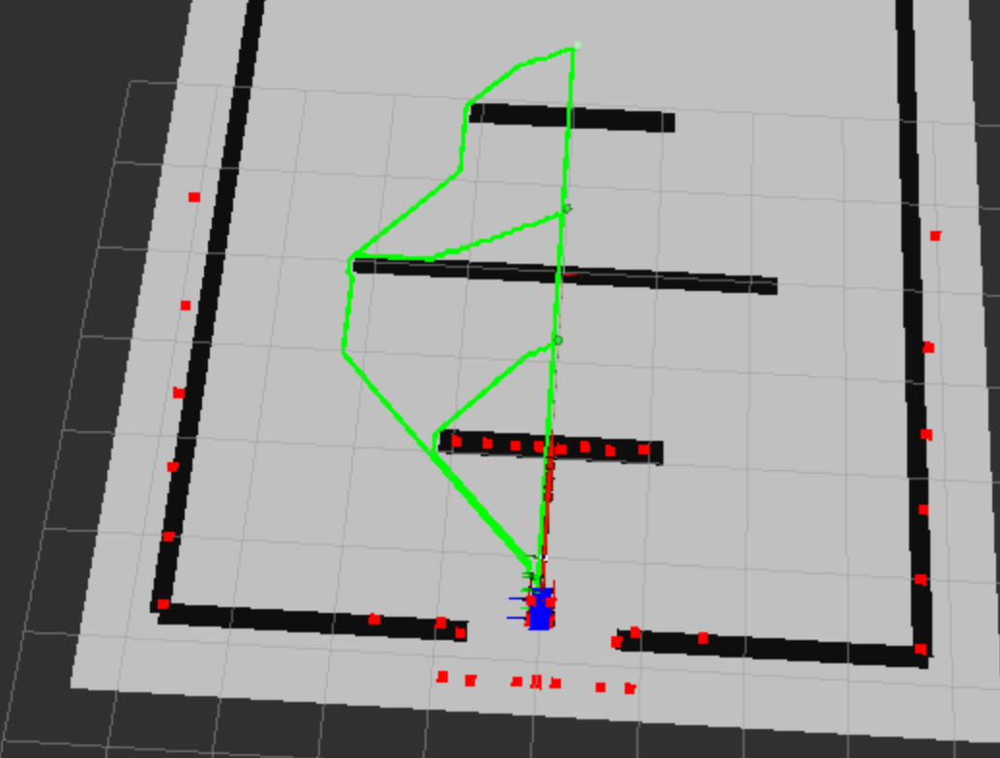
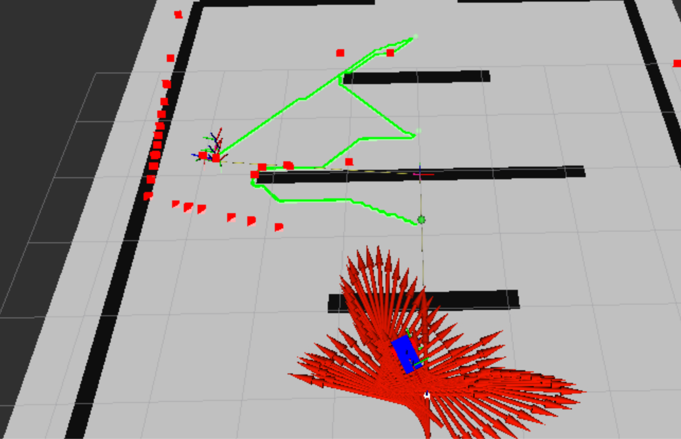
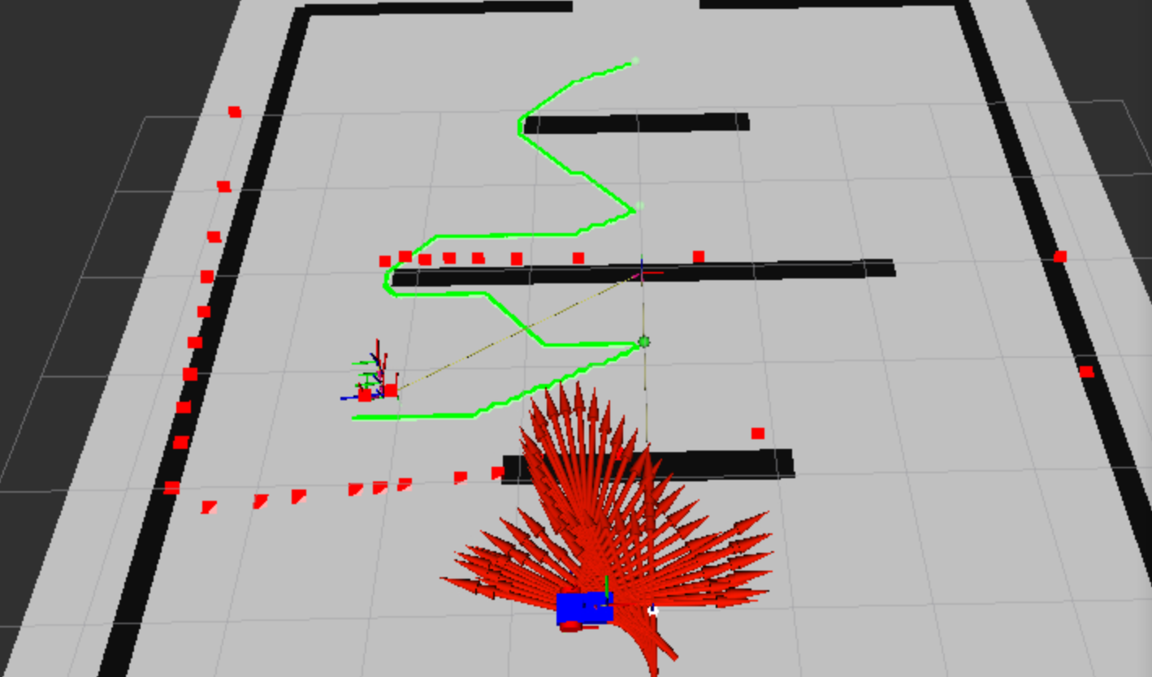
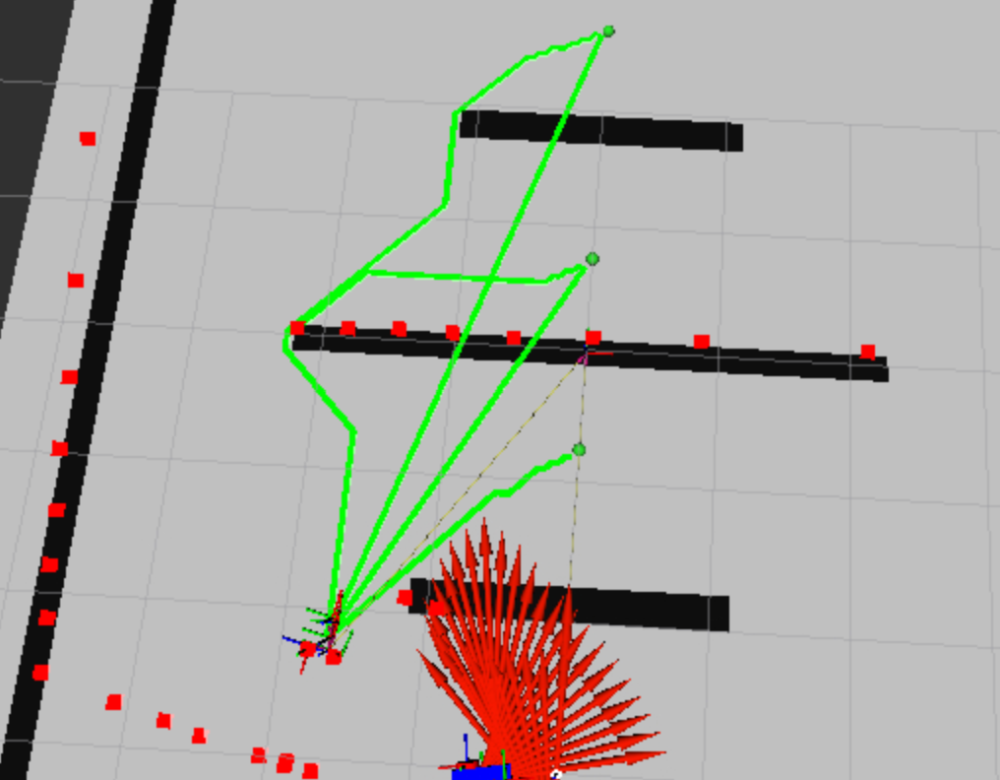
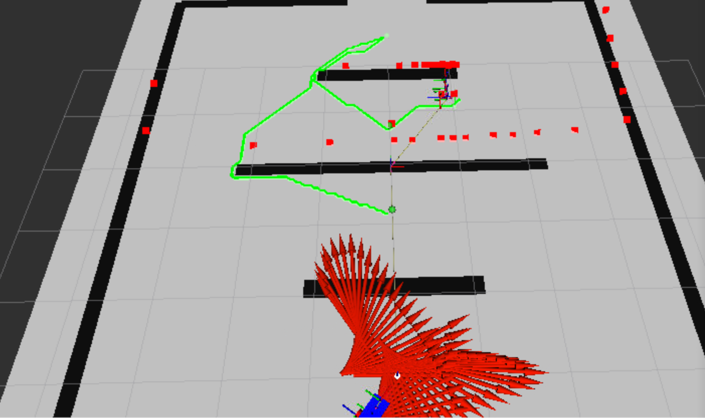
A* Star Chain
Find A* Path from Robot’s position to each goal
Use total weight of each path to construct full chain

Slide 4
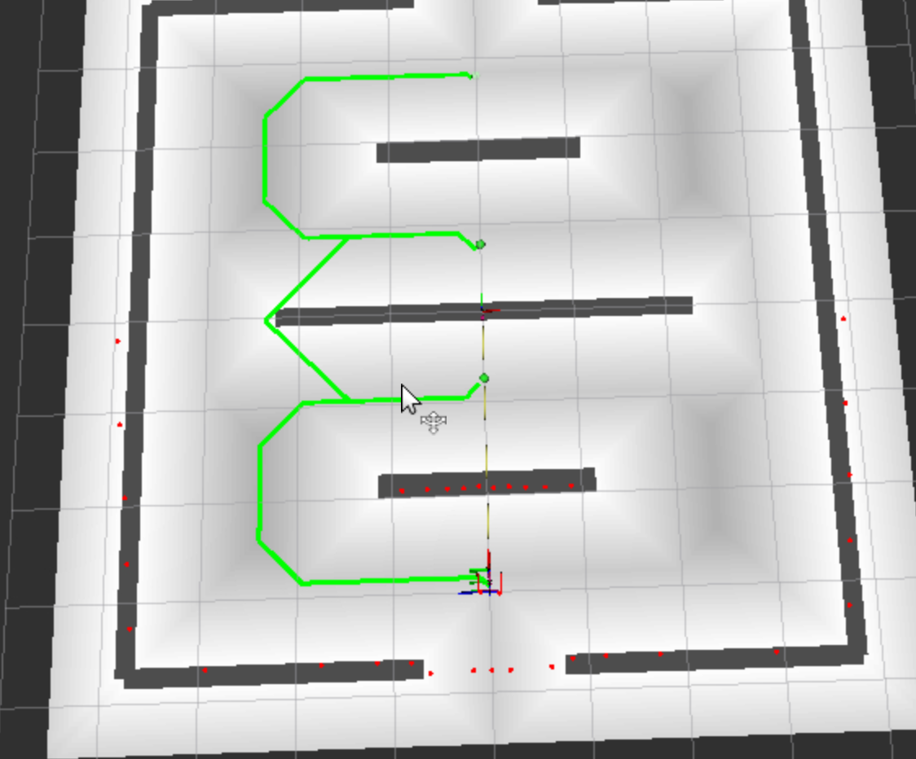
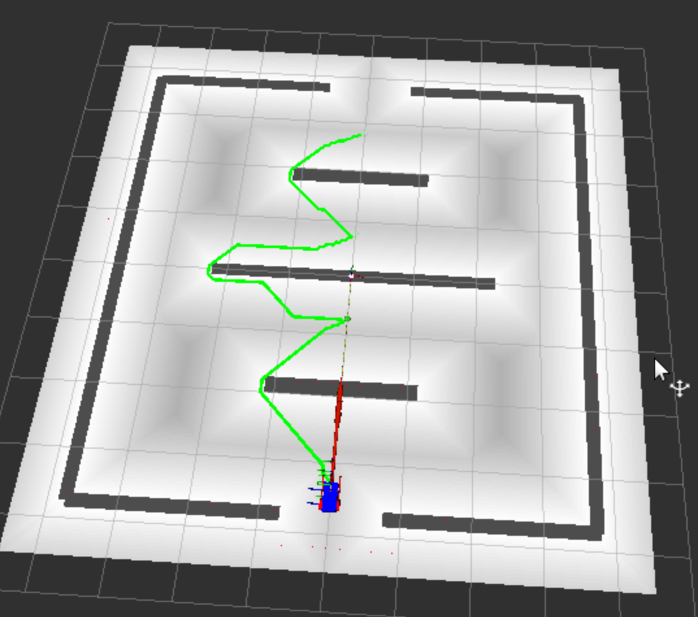
Distance Map Heuristic
Assign a distance D(n) for each node in A* Graph
Node that subscribes to /map and publishes /distance_map topic
f(n) = g(n) + h(n) - λ D(n)
Motivation: Path tends towards free space instead of near walls
With D(n)
Without D(n)

Slide 5
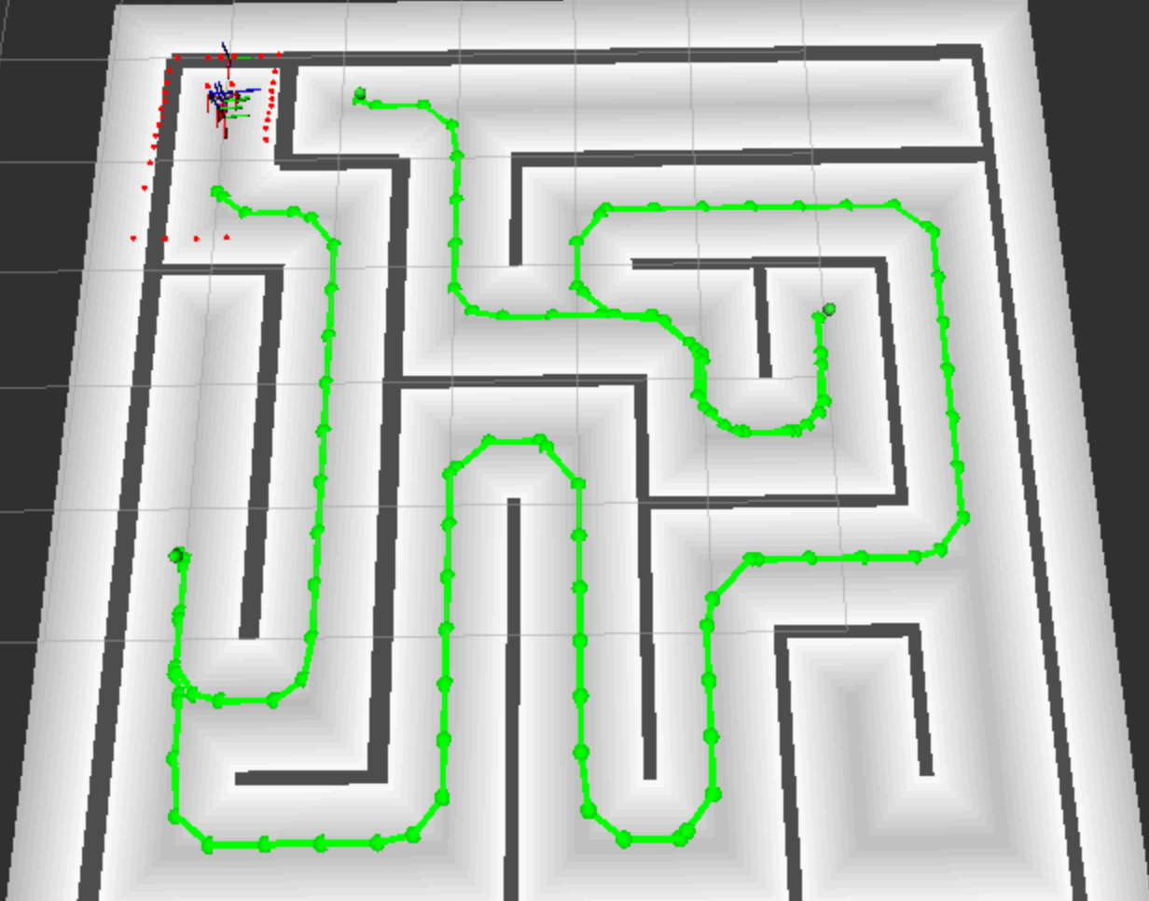
Movement
With the chain, create a series of points to command robot to move towards
Path Publisher node subscribes to the /map, /distance_map and /tf topics and publishes /goal_points and /goal_pose
Node follows along robots progress

Slide 6
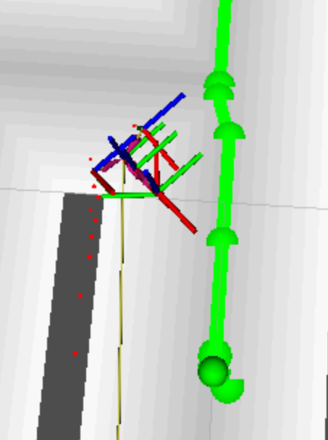
Static vs Dynamic Path Creation
Static
Create A* chain once, follow points sequentially
Issues:
Assumes a map is given
Robot can sometimes skip ahead in path, has to backtrack
Dynamic
Create the A* chain each step, use the first points in the path to follow
Accounts for a changing map environment
Issues:
Computationally expensive
If the robot gets stuck, the first few points in the path will be the same
In both cases the robot gets trapped on corners or walls, or gets stuck trying to get to a point in an awkward orientation

Slide 7
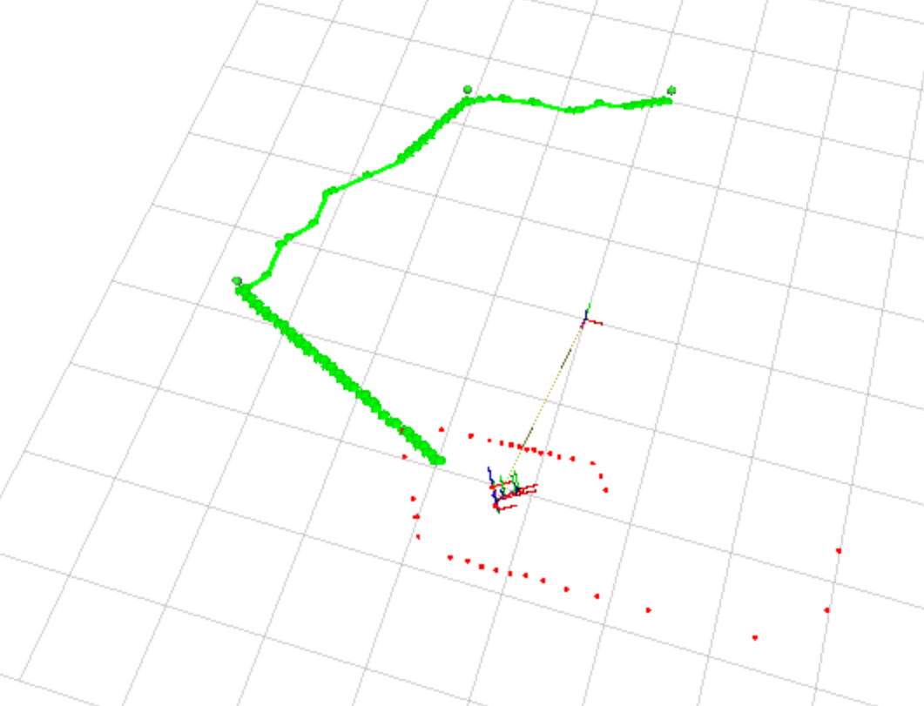
Mapping
Utilized Quadmap() and to_occupancygrid() from previous assignment
Updates map, when map updates path has to update
Treats unknowns as unoccupied
Had issues updating map accurately, most likely due to lidar issue with vertical axis described by other students

Slide 8
Future Improvements
Accurate recovery from walls and corners
Accurate quadmap updates
Tweaking control parameters

Slide 9


